Slide 1
S-GEMS Models of spatial continuity
Modeling Uncertainty in the Earth Sciences

Slide 2
The variogram
Models of spatial continuity

Slide 3
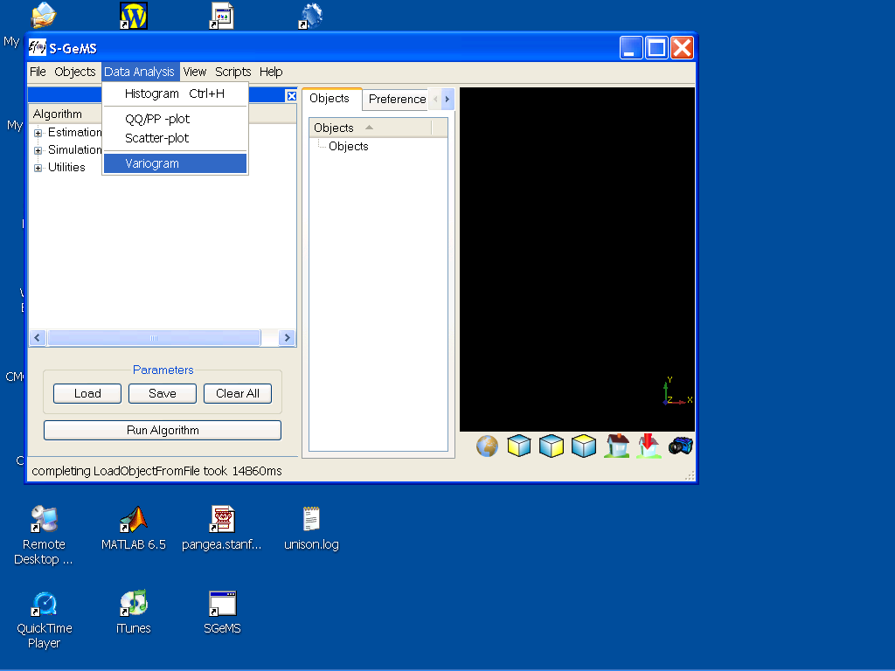
Variogram Calculation in SGEMS
Variogram modeling can be done on any data that is loaded
as an object in GEMS: Cartesian grid or point set data

Slide 4
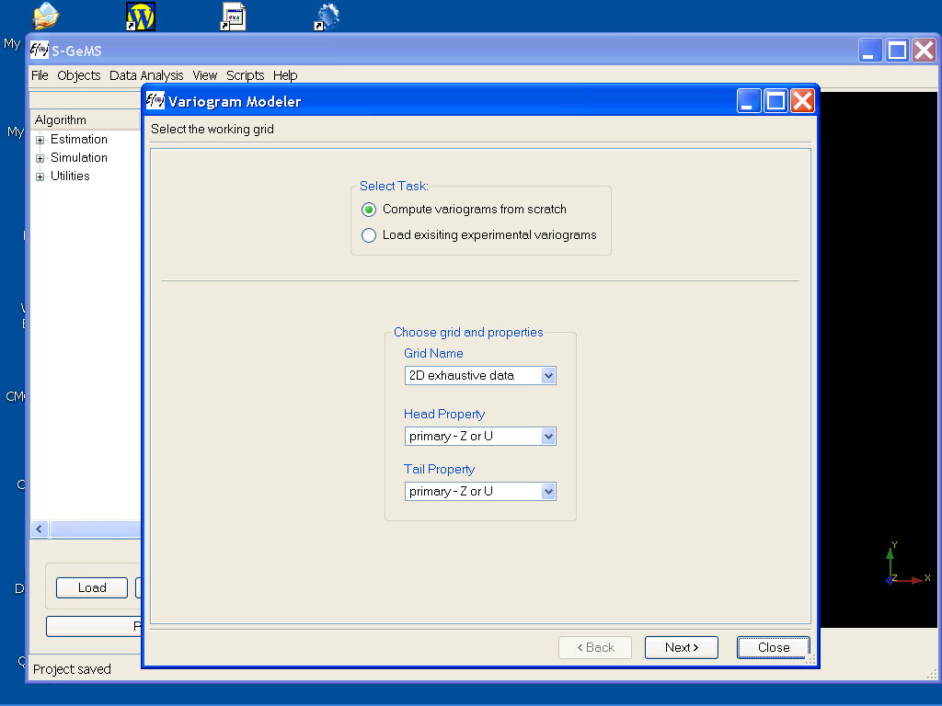
Variogram calculation
Select the grid name or point set
and variable you want to work on
Click Next>

Slide 5
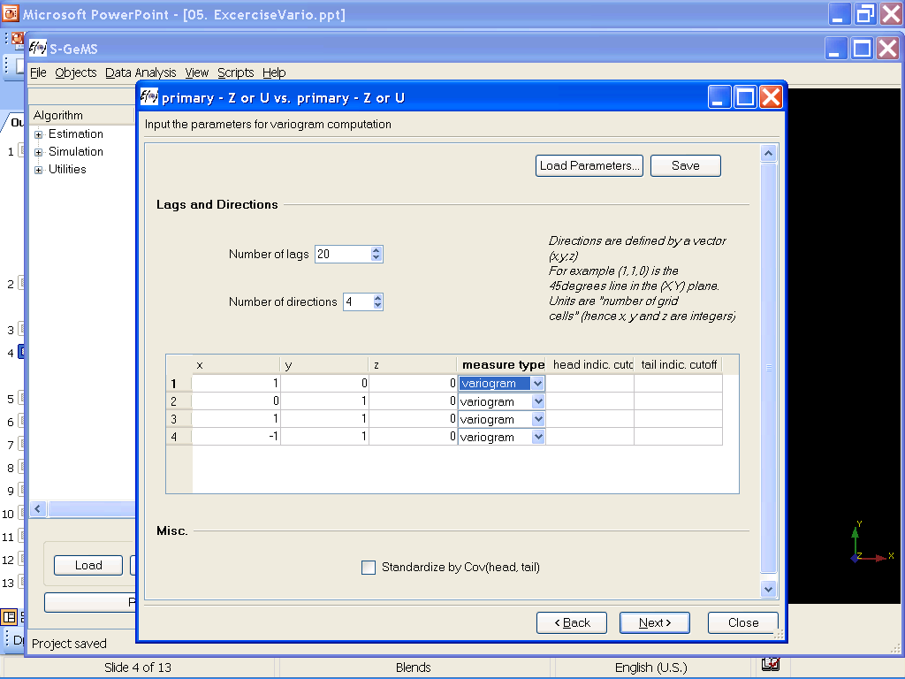
Input calculation parameters
Input the various parameters required
for calculating the variogram in various
directions
Click Next>

Slide 6
For regular grids
Required:
* Number of lags
* # of directions
* Each direction expressed as
grid vector
2
1

Slide 7
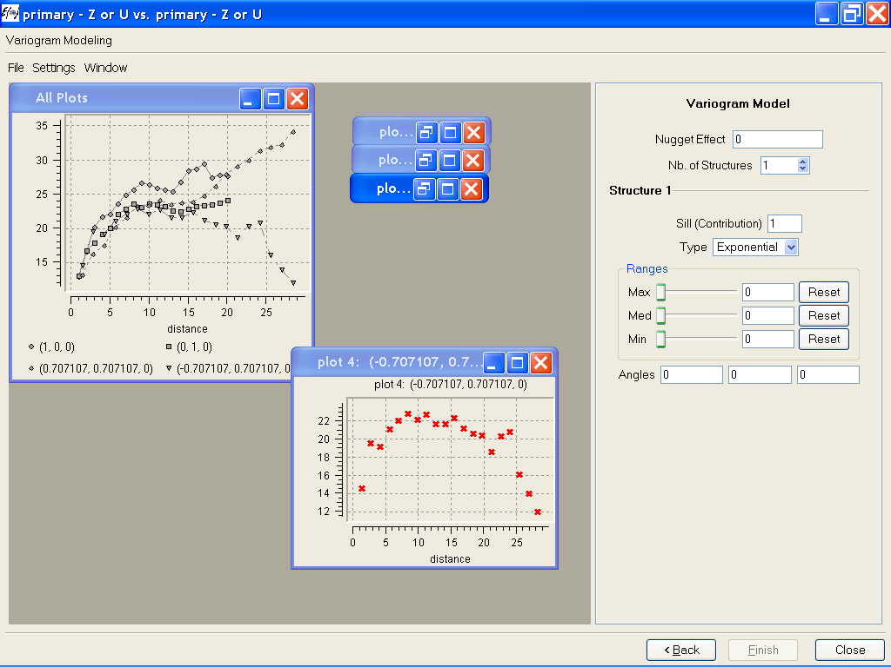
Calculation results
For every direction a plot
is generated

Slide 8
Exercise on variograms
Open the project S-GEMSvario.prj
Calculate the experimental variogram the gridded property.
Calculate the variogram in 6 directions that are somewhat equally spread over [0,180] degrees and the vertical direction.
For each property, analyze and list the most important characteristics of these variograms. Can you relate this analysis to what you see in the 3D dataset. Point out the major differences between the variograms of both properties in the dataset

Slide 9
Irregular data set parameters
* Number of lags
* Lag distance
* Lag tolerance
* Azimuth Angle
* Dip angle
* Angle tolerance
Note: an omni-directional variogram is obtained
by making the angle tolerance 180 degrees

Slide 10
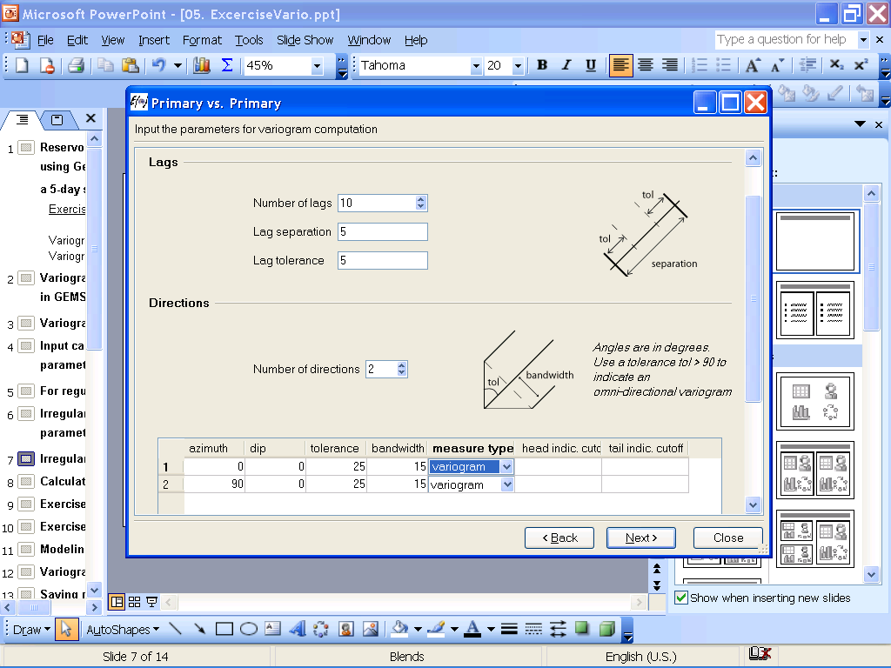
Irregular grid input

Slide 11
Object modeling with Tetris
Models of spatial continuity
Note: Use Beta-version of S-GEMS

Slide 12
What is Tetris?
An object-based simulator for creating training images with the following specifications
It has two hierarchies, objects and elements
It is expandable, new objects can be programmed
It allows for trend in placement and stacking
It has predefine objects such as channel-crevasse lobe system
It allows creating new objects from existing ones using the interface

Slide 13
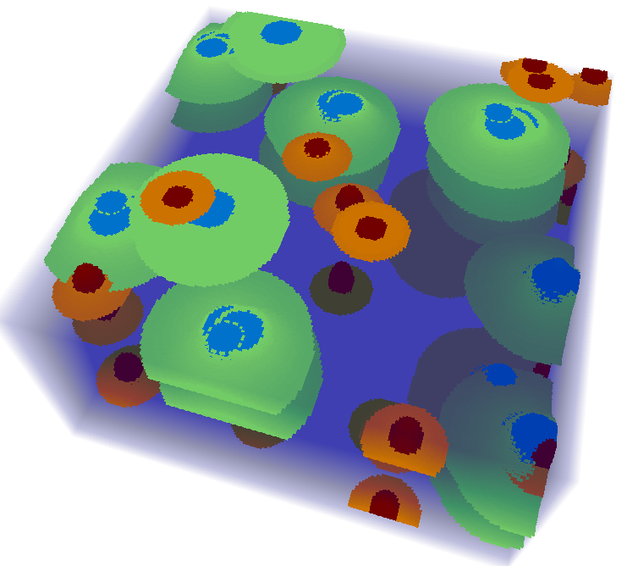
Nomenclature
A Boolean Model = the (model) specification of object geometries, spatial distribution and interaction.
A 3D Boolean Earth model: a creation of one specific simulated spatial distribution of objects that reflect the Boolean model

Slide 14
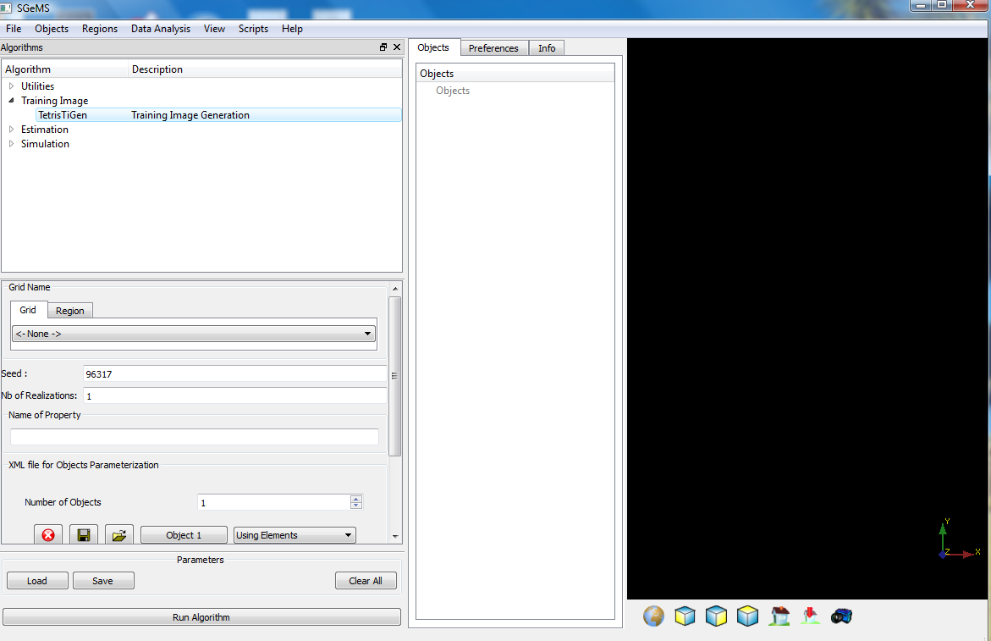
A Boolean simulator
Click on TetrisTiGen to activate the User Interface
Specify the grid
Specify how many TI models you want to generate
Name the property you are modeling

Slide 15
Strategy how to construct a Boolean Model ?
Work first on paper, drawing conceptually what you want to create from the data that is given to you
Define first what will be object and what will be element (there is no unique solution here)
Define the objects
Define the placement and interaction of objects
Go in small steps and run the simulation many times to check whether what you get is what you had in mind. Don’t try to get it all correct in one go.

Slide 16
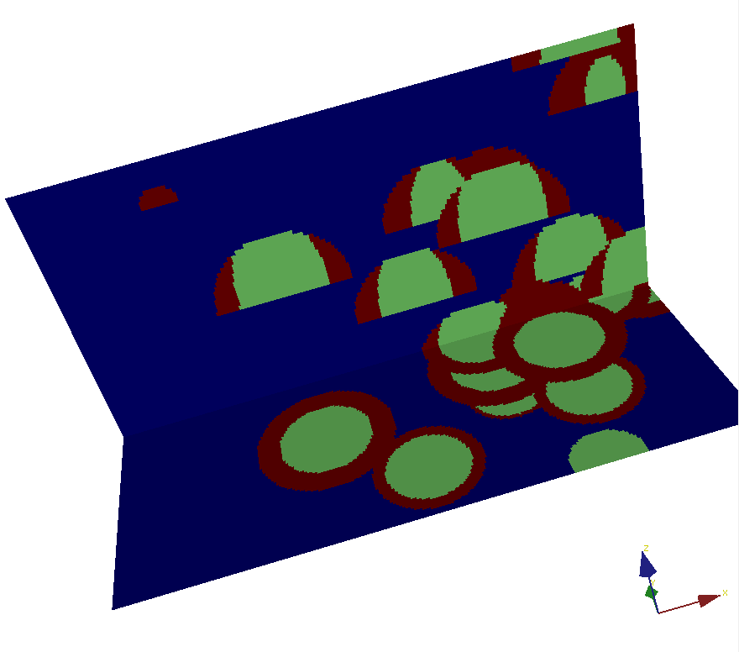
Let’s try and make this

Slide 17
What do we observe ?
A mound object consisting of two elements (red and green)
More objects on the right than on the left

Slide 18
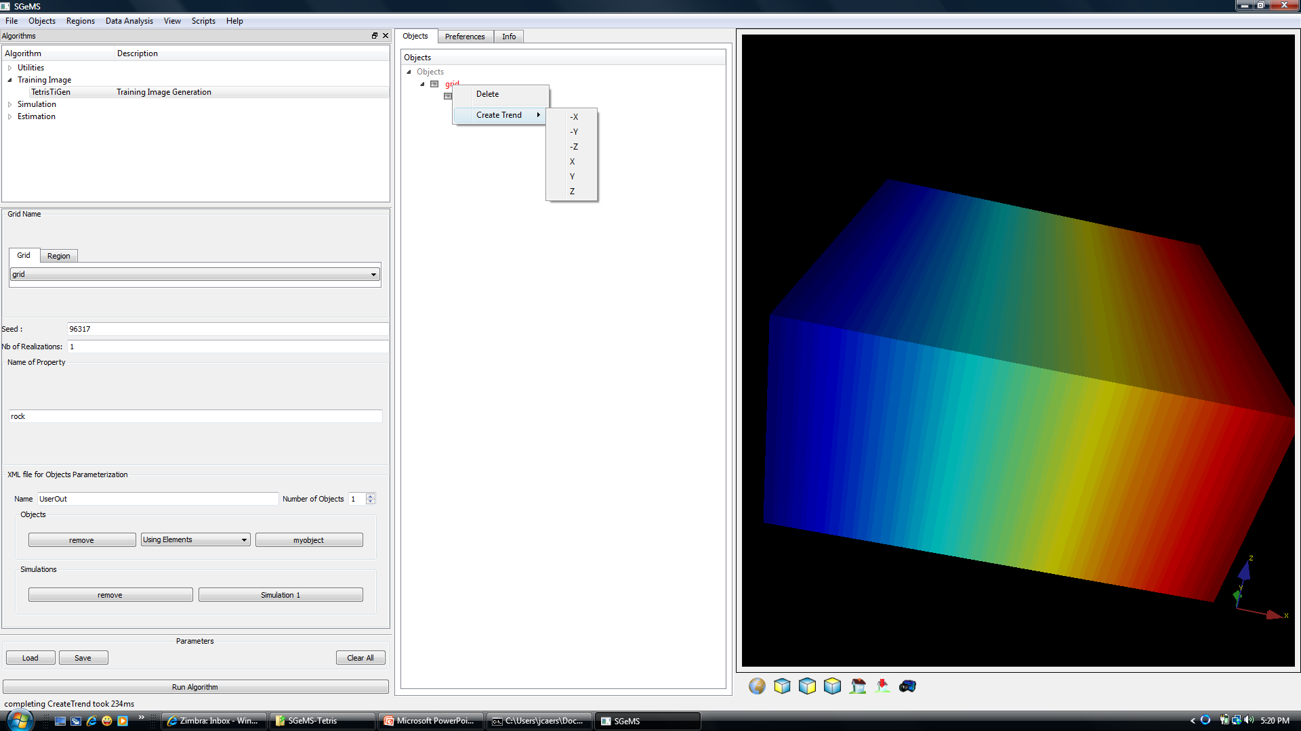
Creating trends/intensity functions
Right click on grid to create trend functions

Slide 19
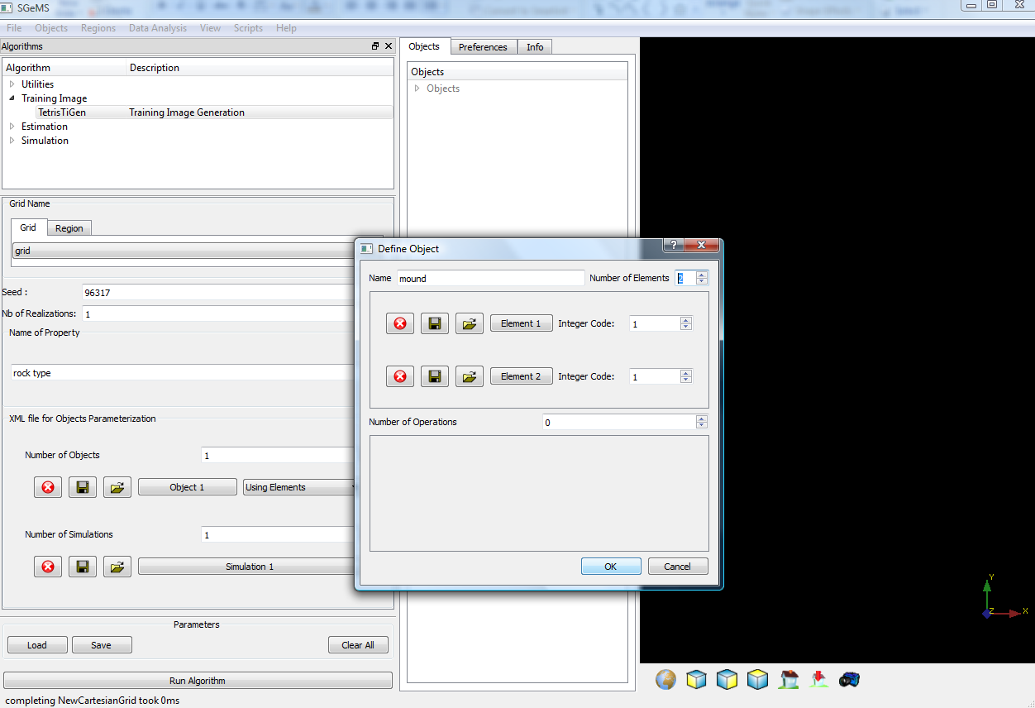
Object definition
Name the object you create
(make sure to use different names of
or all objects and elements you create)
Number of elements

Slide 20
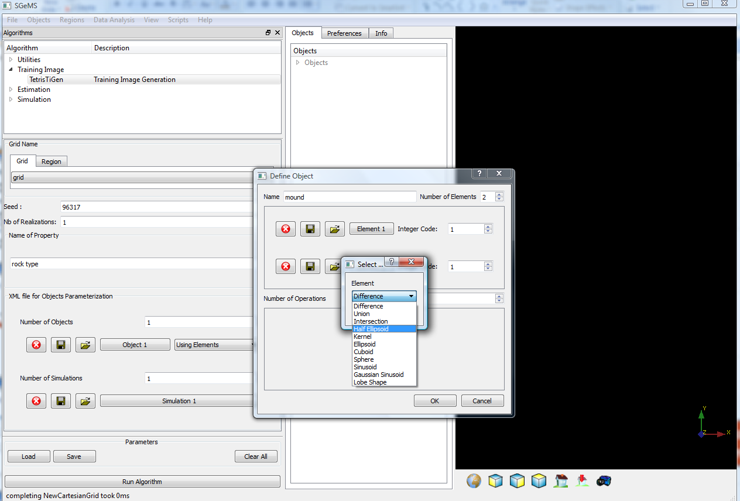
Element definition
Clicking on element and
select the geometry for that element

Slide 21
Available geometries for elements
Known mathematical geometries
Ellipsoid/Sphere
Cuboid
Kernel (looks like a Mexican hat)
Important geometries for the Earth
Sinuoid (rivers)
Gaussian sinusoid (meandering rivers)
Lobe shape
Use union, difference and intersection to create new element geometries from existing ones

Slide 22
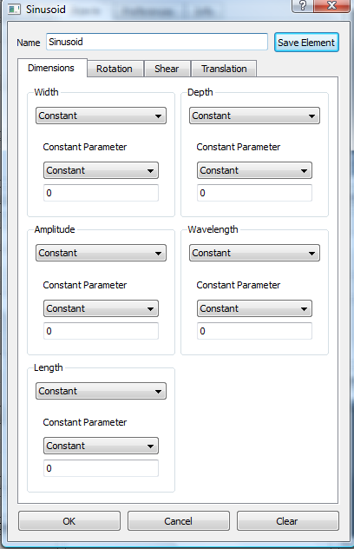
Sinusoid

Slide 23
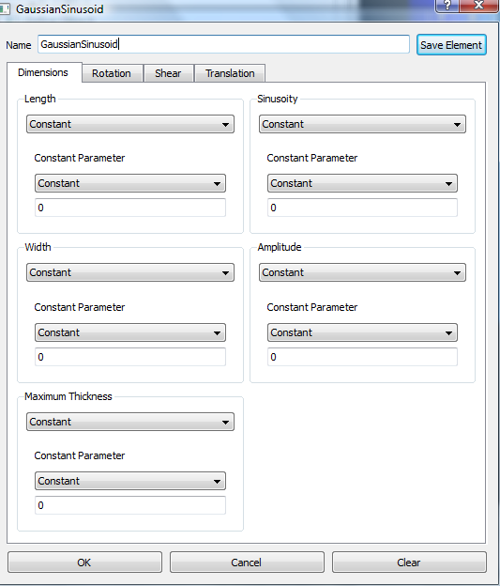
Gaussian Sinusoid
Width
y
Length
x
Sinuosity = 2 times average length between peaks
Amplitude = Average variation around the axis
x
width
z
thickness

Slide 24
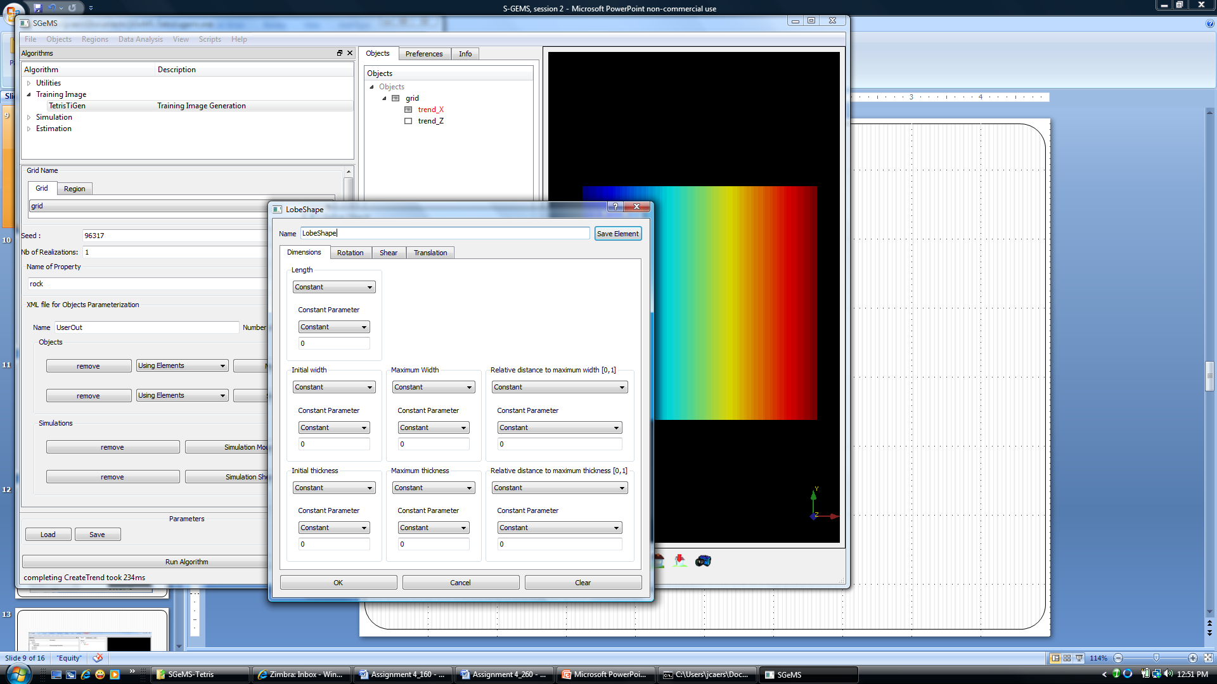
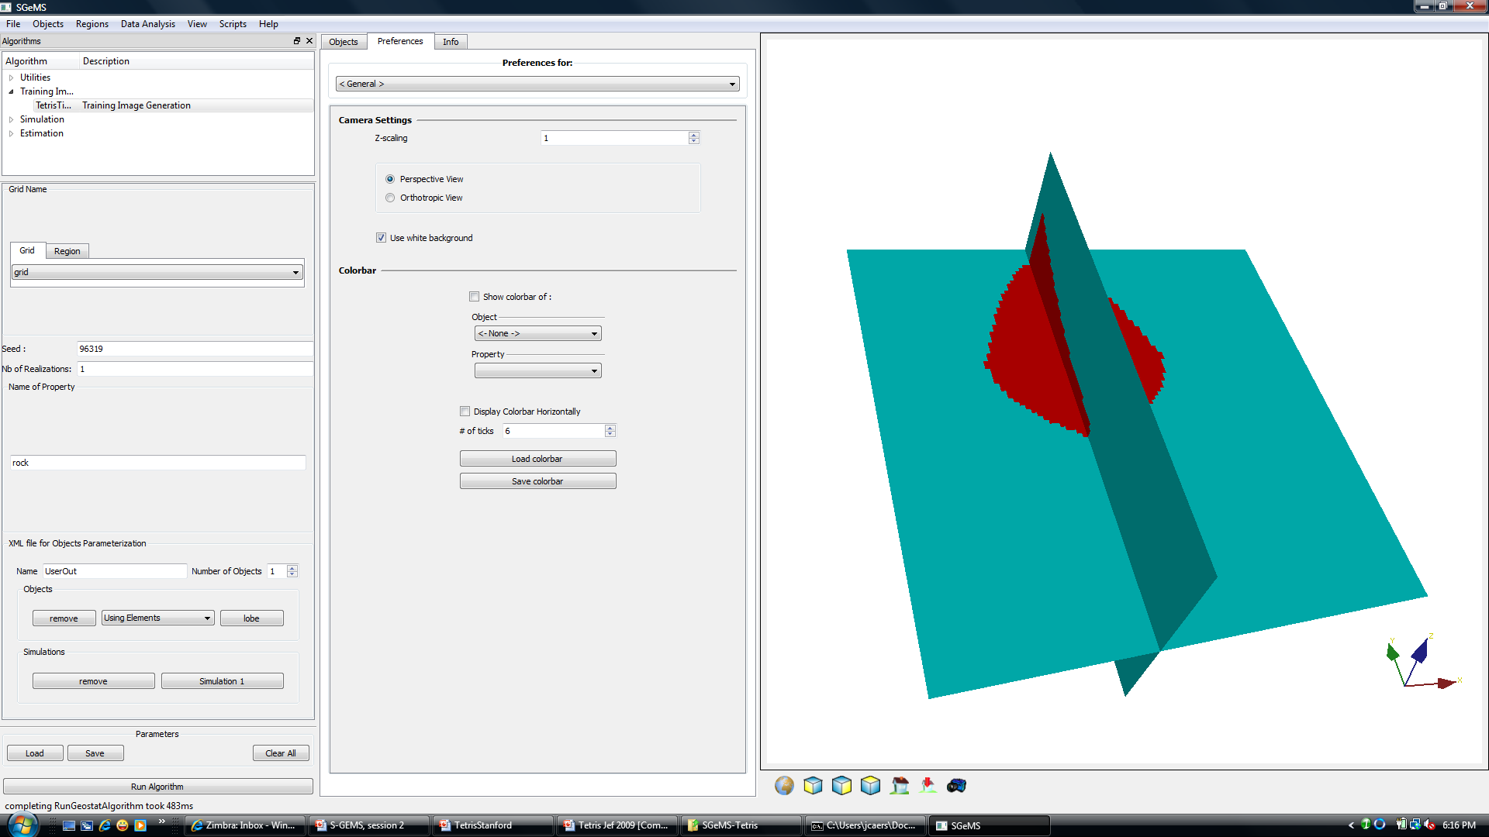
Lobe shape
Max thickness
Initial thickness
width
Relative distance
Some along thickness
thickness
width

Slide 25
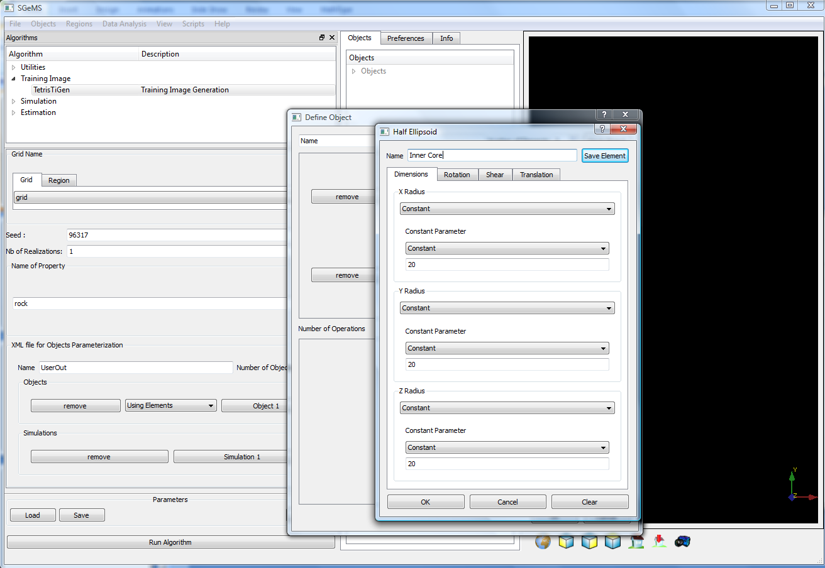
Dimensions
Name the element you create
(again always change this
so you have different names)
Dimensions can be constant
or have a triangular distribution
pdf
min
mode
max

Slide 26
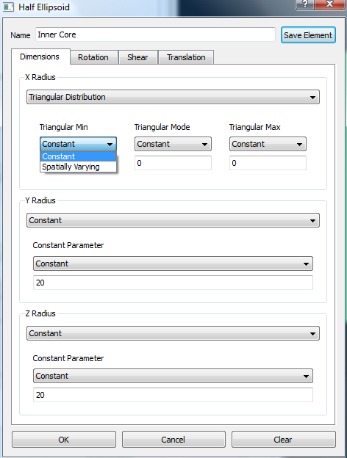
Spatially varying parameter values
Each element geometry can be modified through rotation, shear and translation
Every parameter can be a value that is constant over the grid or varies according to a spatially varying
intensity function

Slide 27
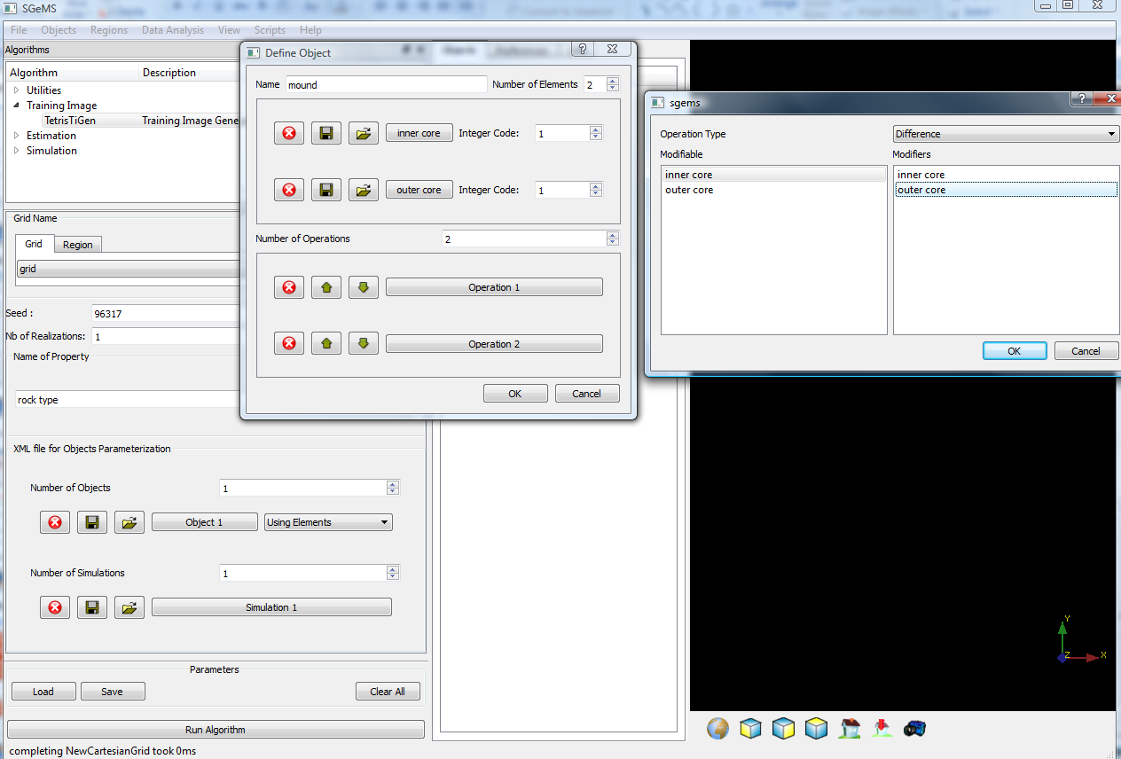
Object definition
Enter a code that makes each element unique, this integer code will be used to create the 3D Earth models
If needed, define operations such as difference and intersection between the defined elements to create the object
Operation require the specification of what element is modified and which one modifies it
The element selected is highlighted when clicked on

Slide 28
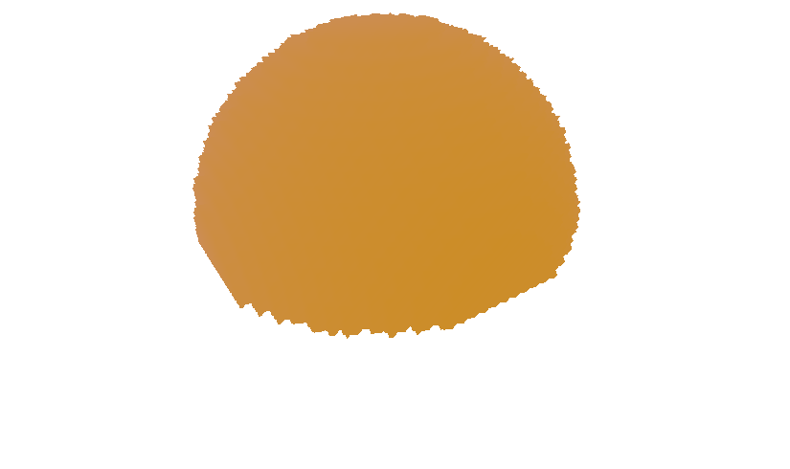
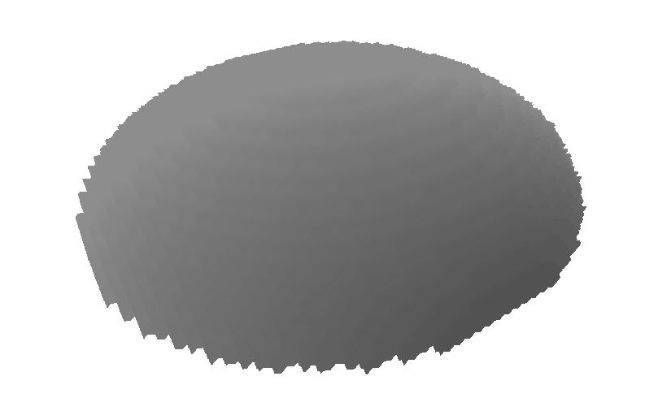
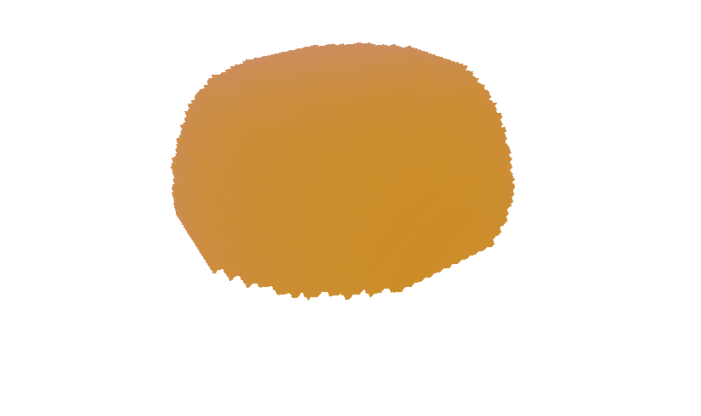
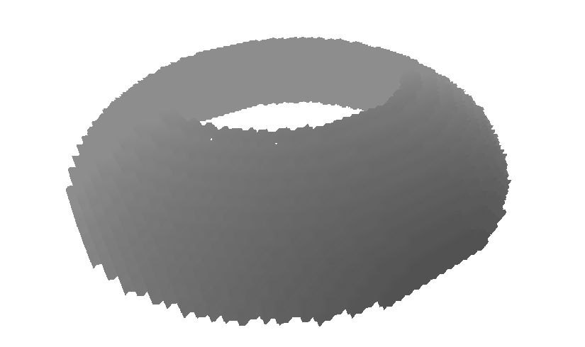
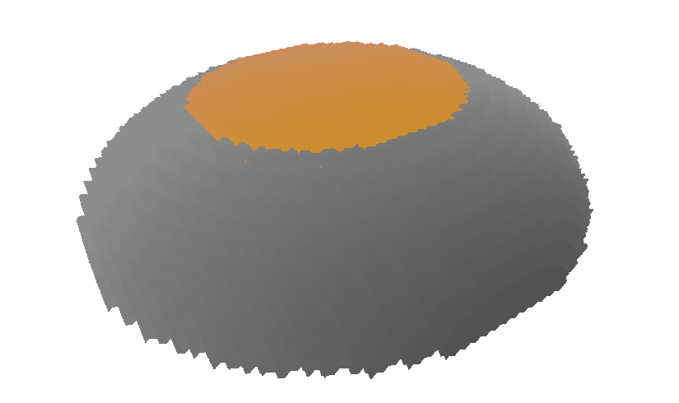
Object definition, example
inner = HalfEllipsoid( 20,20,20 )
outer = HalfEllipsoid( 30,30,15 )
inner.intersection( outer )
outer.difference( inner )
Resulting Object

Slide 29
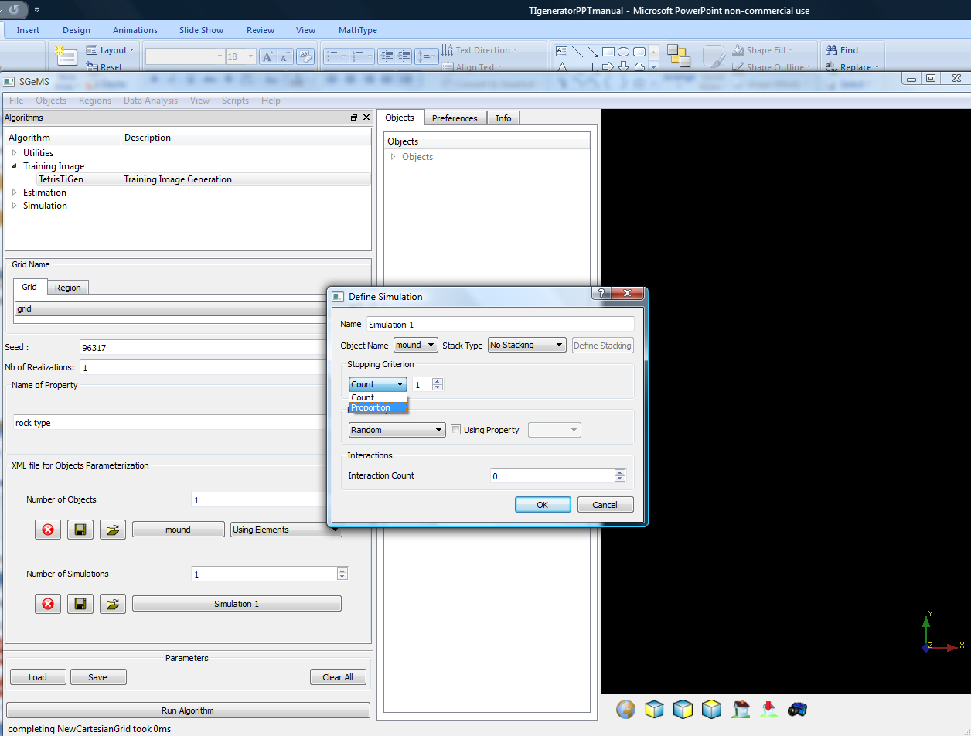
Define placement of object
Specify how many of these objects you want to simulate or, specify a proportion of that object relative to the entire grid
Click to specify how to place (simulate) the object on the grid)

Slide 30
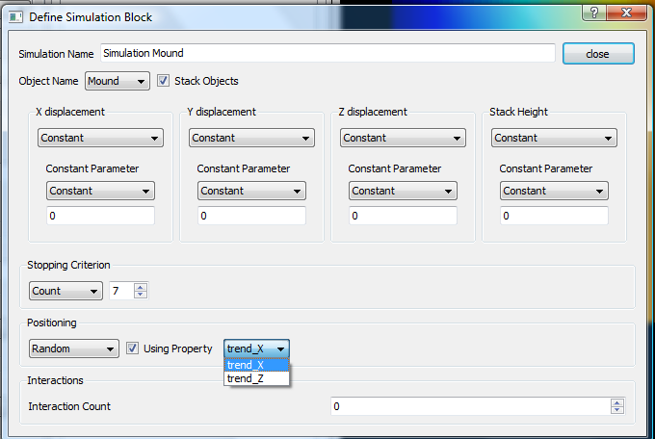
Changing the spatial density of locations of objects
Trend in placement can be entered here, for example Trend_X = more objects in the East than West

Slide 31

Stacking
Stack height equals the number of objects that will follow the stacking pattern specified in X/Y/Z-displacement. When the stack height is reached, then the next object is placed randomly and a new stack is started
Base plane
Z-displacement
X-displacement

Slide 32
Stack height
Stack height = 5 (note, this constant can also be made a random variable)
Z

Slide 33
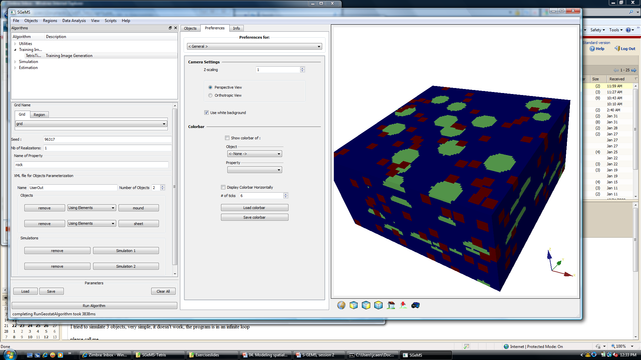
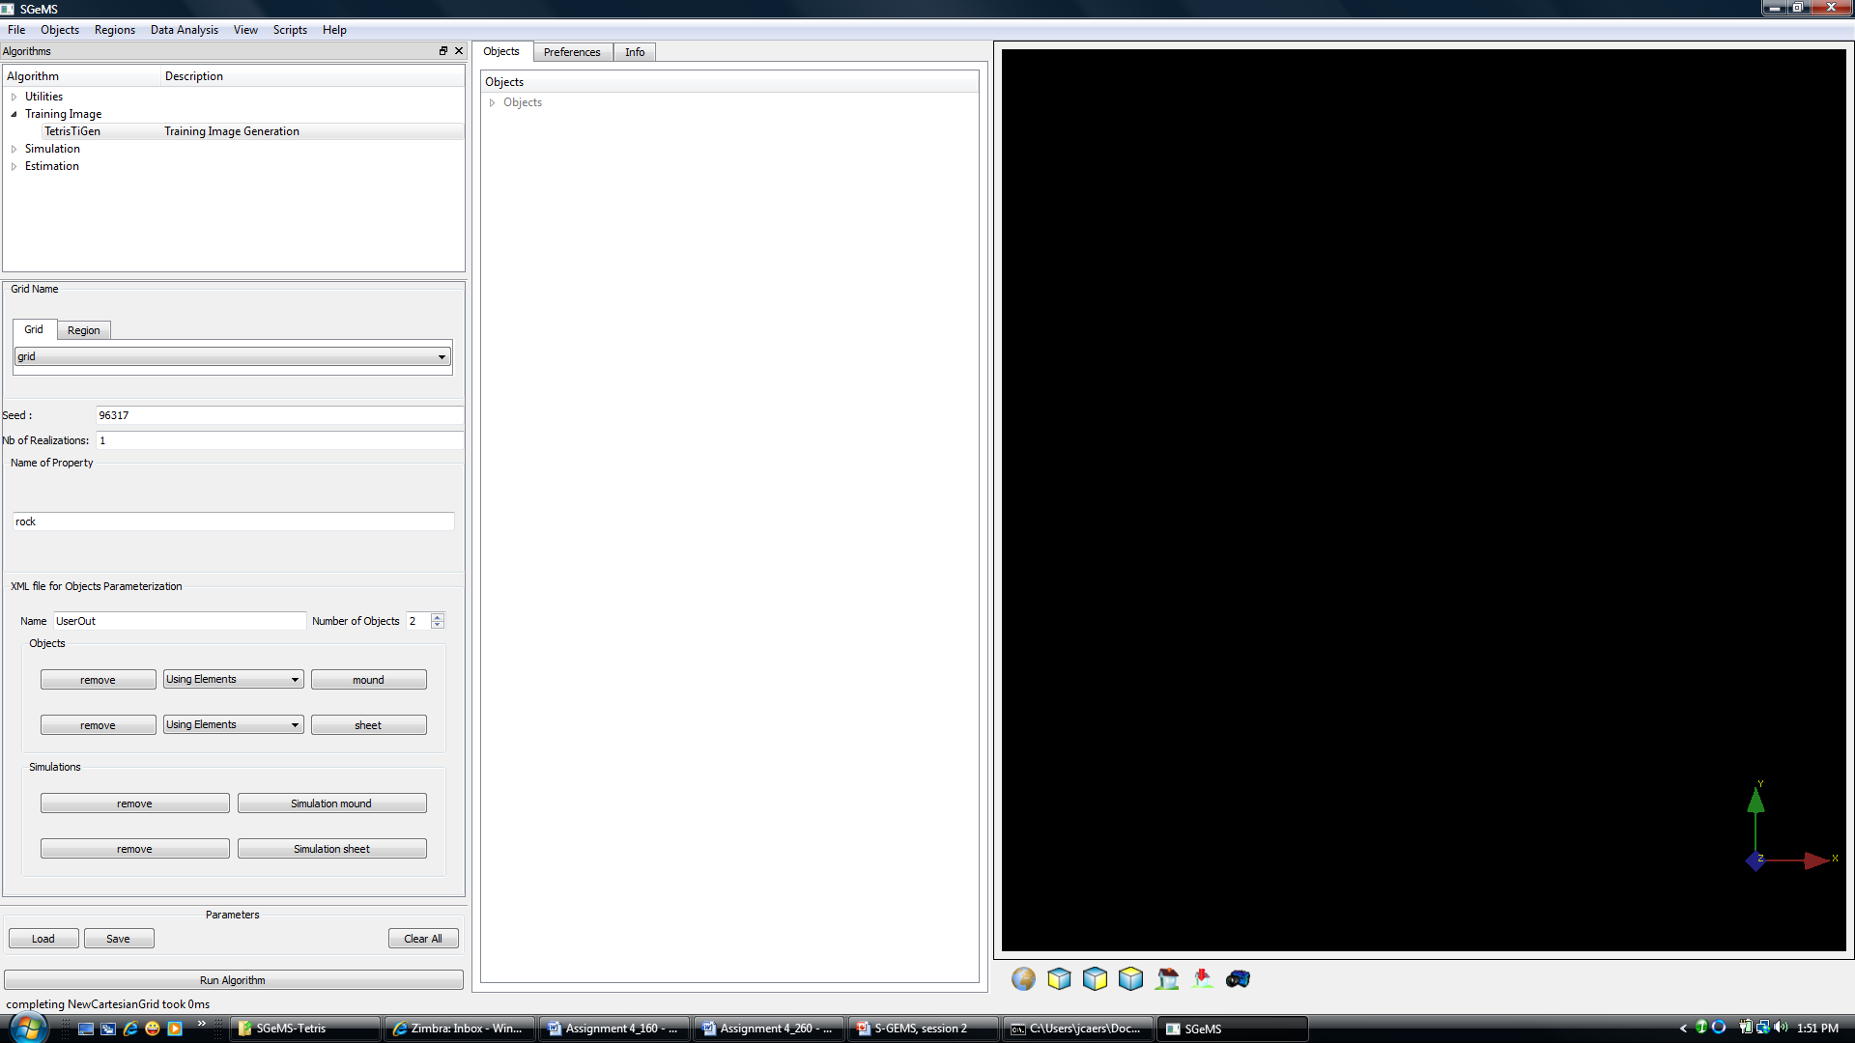
Multiple objects
Object defined higher in the list gets eroded by objects further down the list

Slide 34
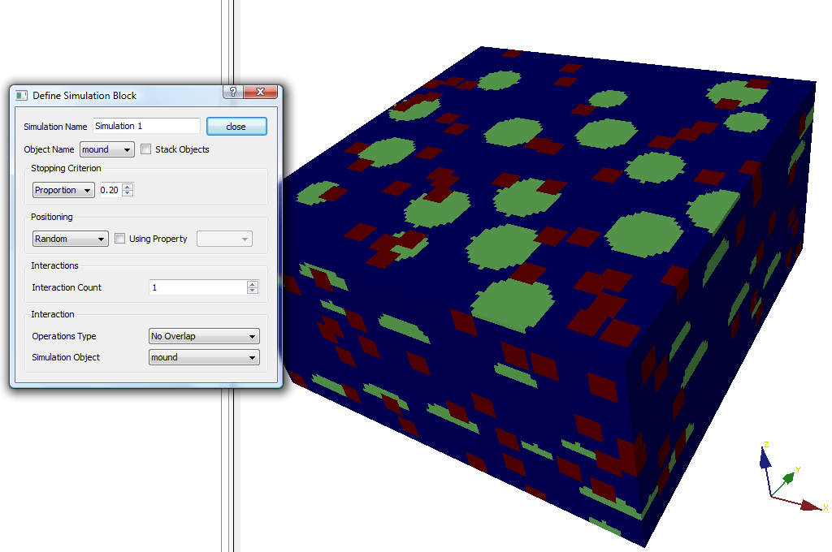
Interaction between objects
Define relationship with
other objects or with itself

Slide 35
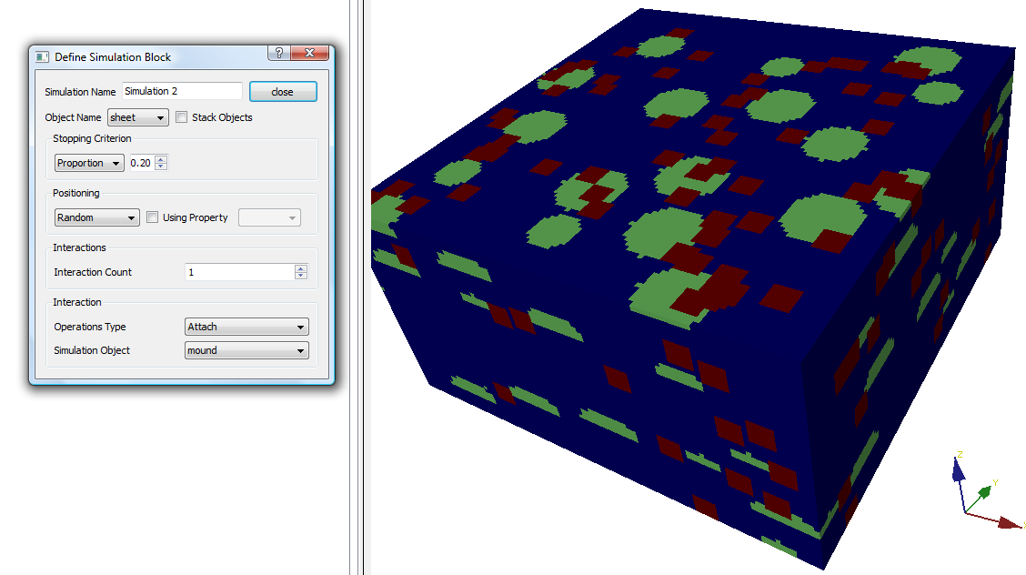
Attaching

Slide 36
Convergence
Stops when either
Specified proportion of objects is reached
Specified count of objects is reached
Various definitions of interaction, positioning, dimensions may conflict, hence no convergence is reached

Slide 37
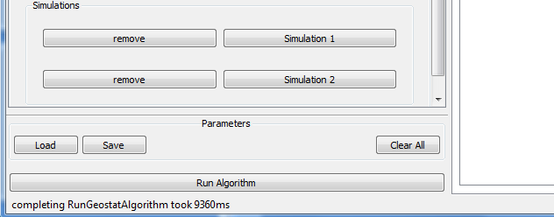
Save/Load feature
Every individual object and element is saved in a XML file
Make sure to is the Save button frequently to save intermediate results they can be reloaded at any time

Slide 38
Pre-defined objects
Certain geometries often observed in reservoirs are pre-defined in S-GEMS, so the user does not have to build them
Example are
Channel-lob-crevasse
Simple carbonate mound

Slide 39
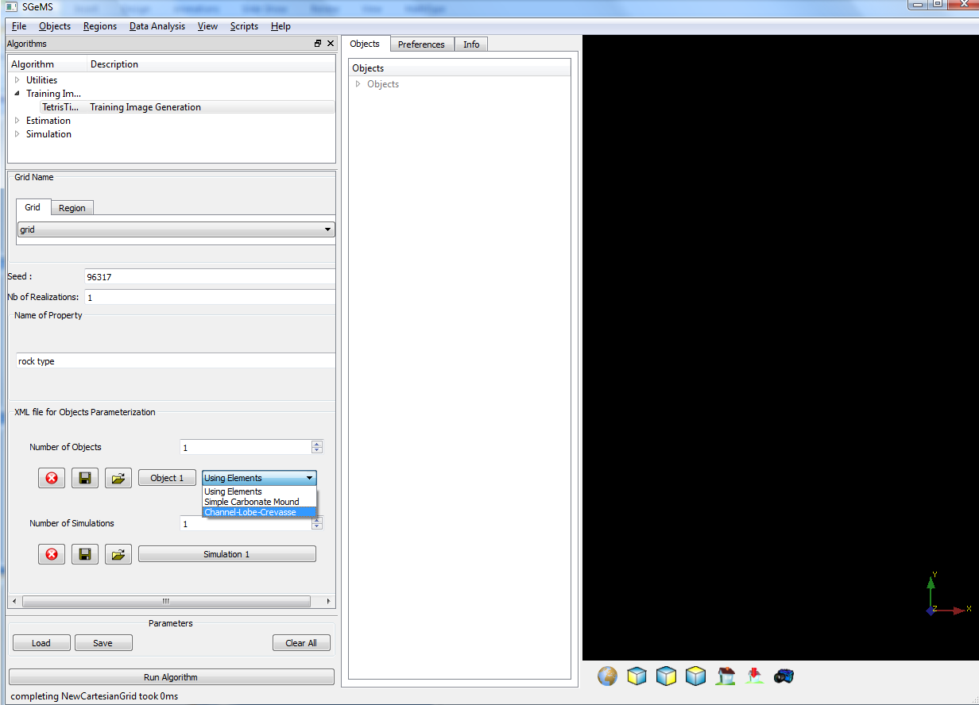
Channel-lobe-crevasse
Click to select a pre-define object

Slide 40
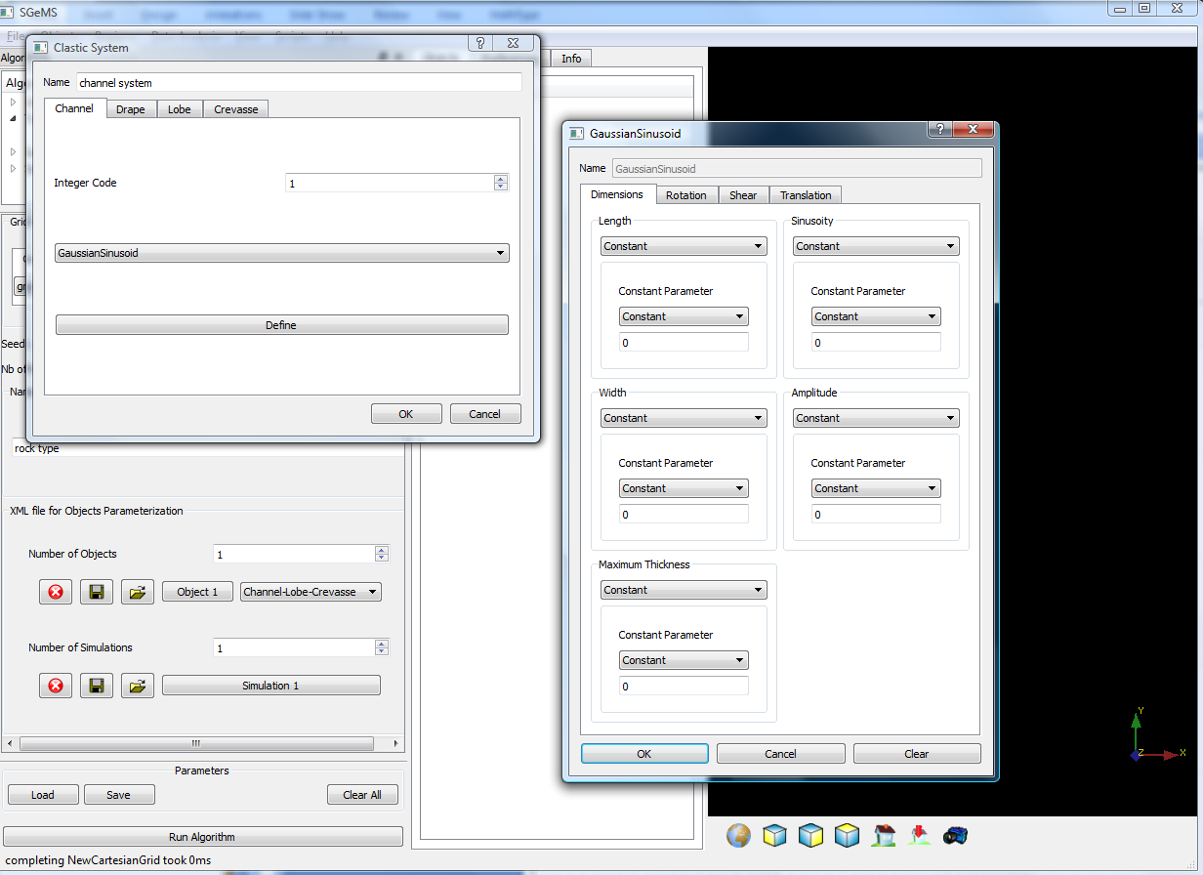
Channel-lobe-crevasse system
Objects are now predefined

Slide 41
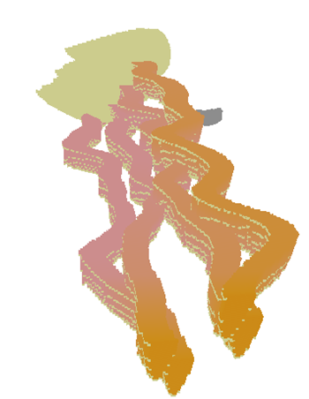
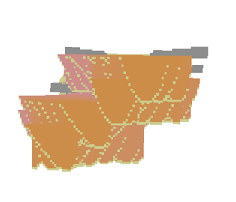
Example

Slide 42
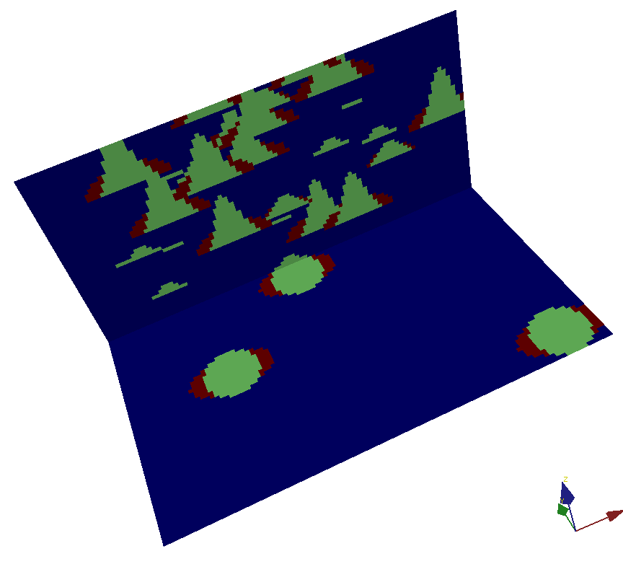
Practice exercise 1
Try and reproduce the spatial relationships seen in this figure
Grid: 100 x 100 x 50

Slide 43
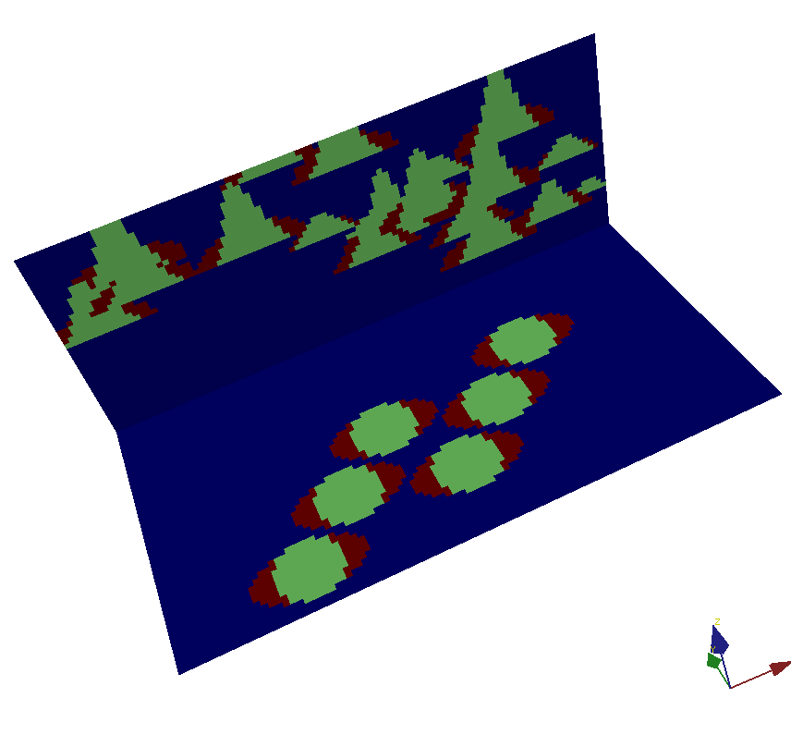
Practice exercise 2
Try and reproduce the spatial relationships seen in this figure
Grid: 100 x 100 x 50

Slide 44
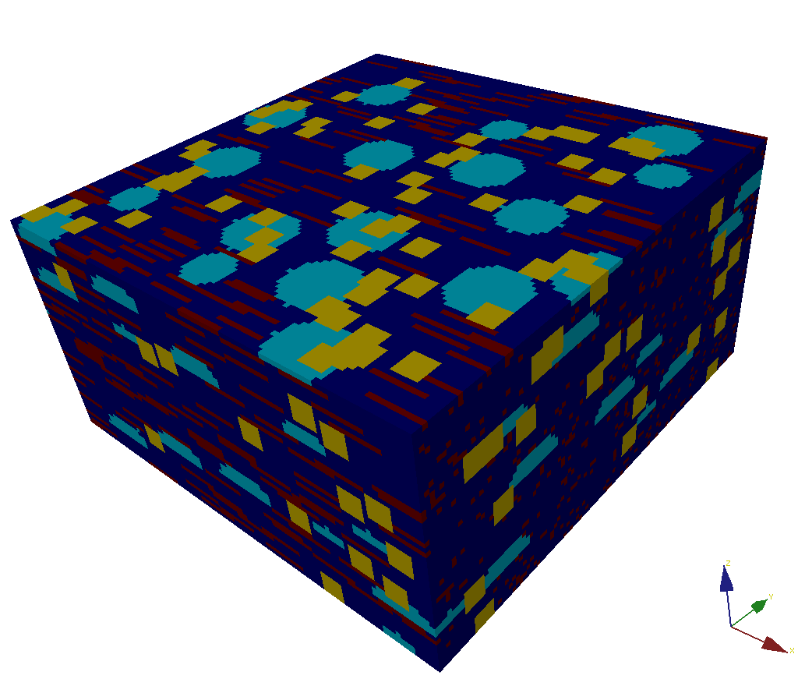
Practice exercise 3
Try and reproduce the spatial relationships seen in this figure
Grid: 200 x 200 x 100

